Slide 1

CASCON Community Hack-a-Thon

Slide 2
The Scott Mission
Christian organization offering programs to support the poor and homeless
Commemorating 70 years serving the community
Men’s Ministry: counseling, fellowship, meals, laundry and shower facilities, shelter
Women & Family Ministry: groceries, free clothing, Bible studies, parenting groups, counseling
Camp & Youth Ministry: after-school program in Lawrence Heights, summer camp
Childcare Ministry: low-cost daycare

Slide 3
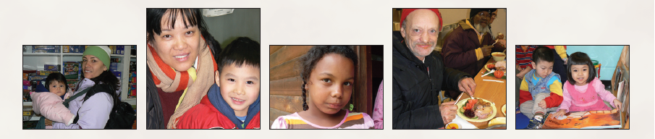
The Scott Mission… by the numbers
45 men sheltered each night
64,209 hot meals and bag lunches
5,200 men clothed and given toiletries
100s of winter coats and boots
600 children sent to summer camp
44,482 bags of groceries

Slide 4
The Scott Mission… by the numbers
29,820 people given free, quality clothing
5,976 baby items
325 backpacks for back-to-school
2,917 Christmas grocery gift cards
2,568 children received toys for Christmas
- 2010 Annual Report, The Scott Mission

Slide 5
Who visits our food bank?
39% are children
64% are families with children
35% have at least a post-secondary education
12% children go hungry at least once/week
26% adults go hungry at least once/week
38% adults who haven’t eaten for a whole day for lack of money
- Who’s Hungry 2011, Daily Bread Food Bank

Slide 6
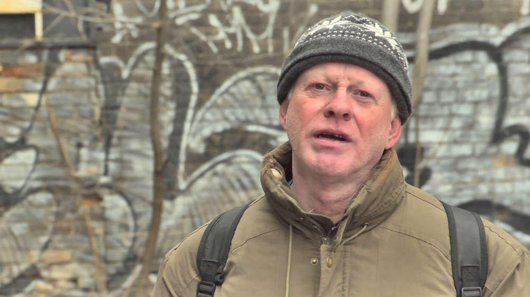

Slide 7


Slide 8
Getting the word out
10 mailings a year to donors, including 2 newsletters and the annual report
2 acquisition appeal mailings at Thanksgiving and Christmas
Advertisements in the Toronto Star and Globe & Mail at Thanksgiving and Christmas
E-blasts periodically throughout the year

Slide 9
The Hack-a-Thon Challenge

Slide 10
Key Business Problems
Expanding ways in which we share the Gospel
Communicating our needs to the public quickly and directly
Reaching new audiences

Slide 11
Our Goals
Primary Goals
  Share the Gospel with a broad audience
  Develop a channel to instantly share daily devotionals, needs, events, and other news
  Offer a quick and easy way for the public to respond and donate
Secondary Goals
  Engage and mobilize a younger demographic
  Create brand awareness

Slide 12
Proposed Business Solution
Create a smartphone application
Adapted for use across all platforms, including iPhone, Blackberry, Android
Ability to send daily devotionals, push notifications for events, urgent needs and other communications
Allow users to easily make a donation using their smartphone

Slide 13
Proposed Business Solution
Ability to integrate with the user’s smartphone calendar
Allow users to easily share content with friends
Easily link to existing content on the web and social media channels
Ability to add images, video, and other content for viewing

Slide 14
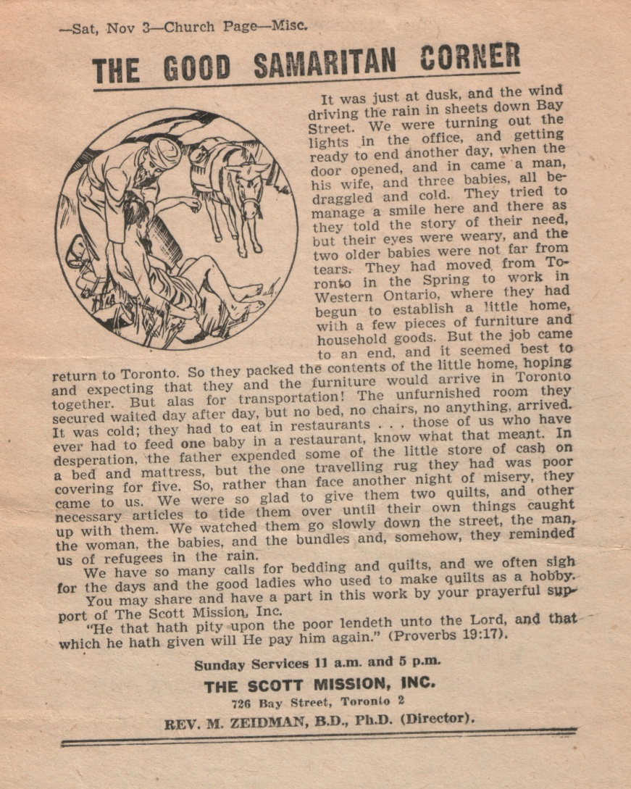
Scenario #1
An individual is looking for a daily devotional for use with their smartphone
The Good Samaritan Corner offers a short and meaningful reading delivered directly to the user’s smartphone each day

Slide 15
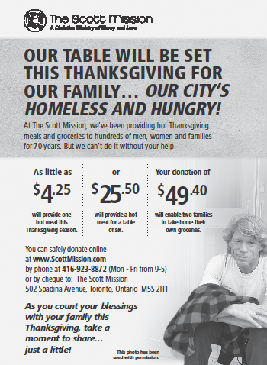
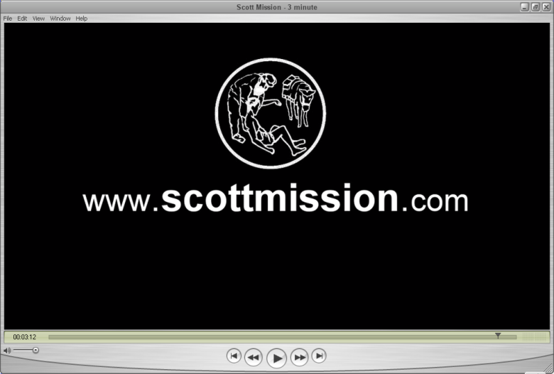
Scenario #2
An individual sees the Mission’s ad in the paper or PSA on TV
An app with a “donate now” function allows the interested donor to respond while the message is fresh in their mind

Slide 16
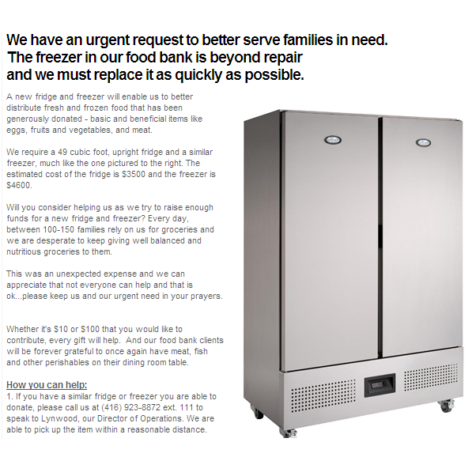
Scenario #3
A new freezer is needed to replace one beyond repair in the food bank
A push notification alerts users to our urgent need and allows them to give immediately

Slide 17
Questions?

